Slide 1
Neptun registration
Students have to register in the beginning of every semester
Please choose Registration/Enrollment in the Administration menu

Slide 2
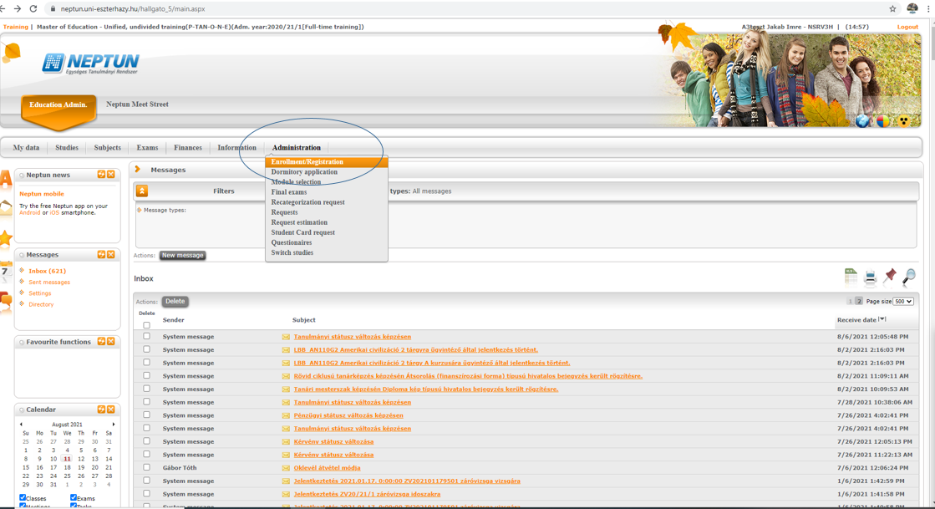
www.oktatas.uni-eszterhazy.hu

Slide 3
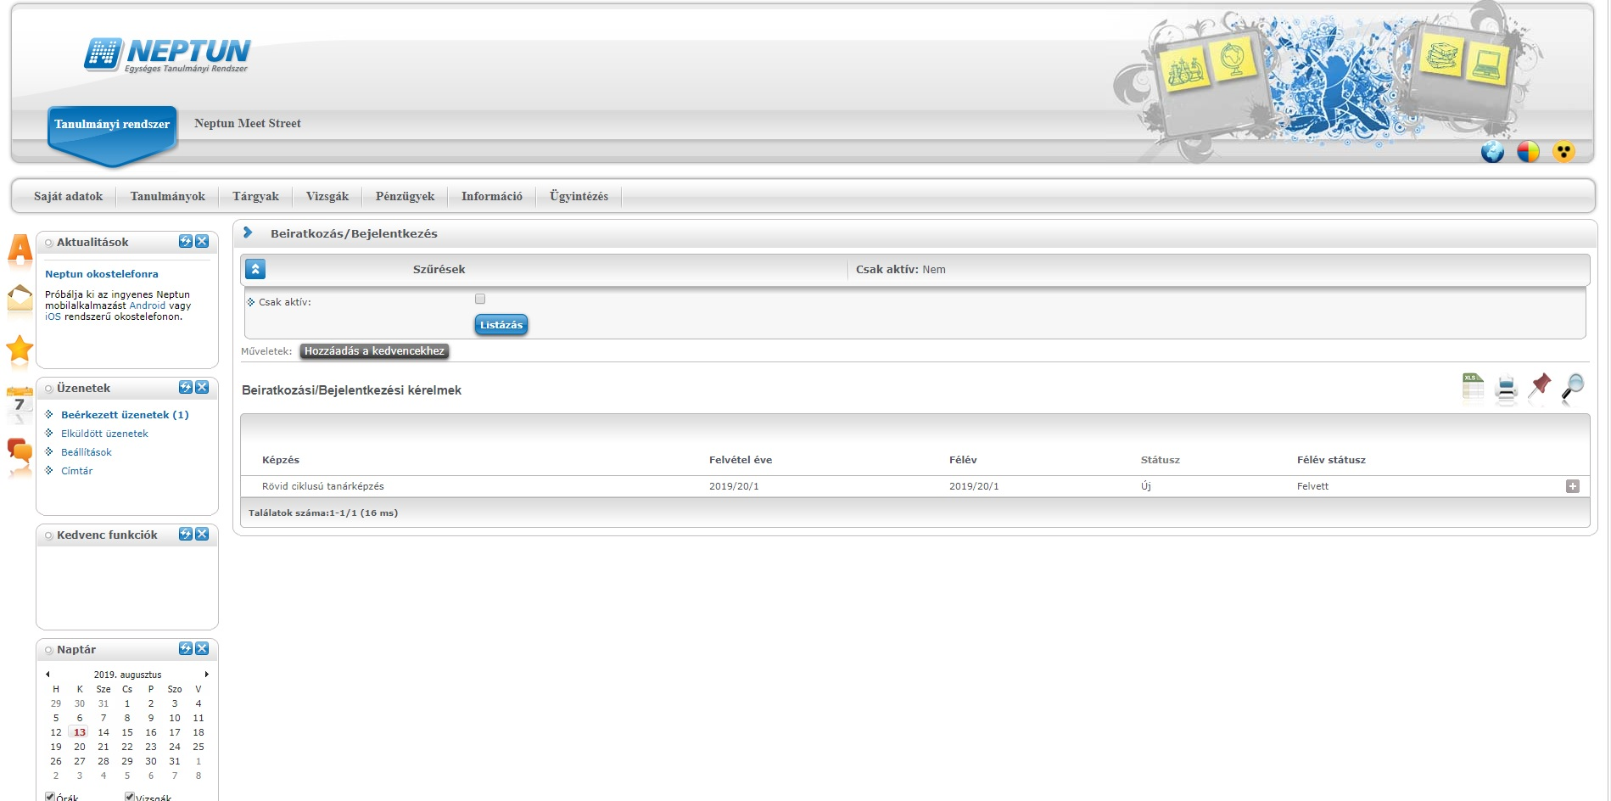
Please choose the(+) sign at the end of the row
www.oktatas.uni-eszterhazy.hu

Slide 4
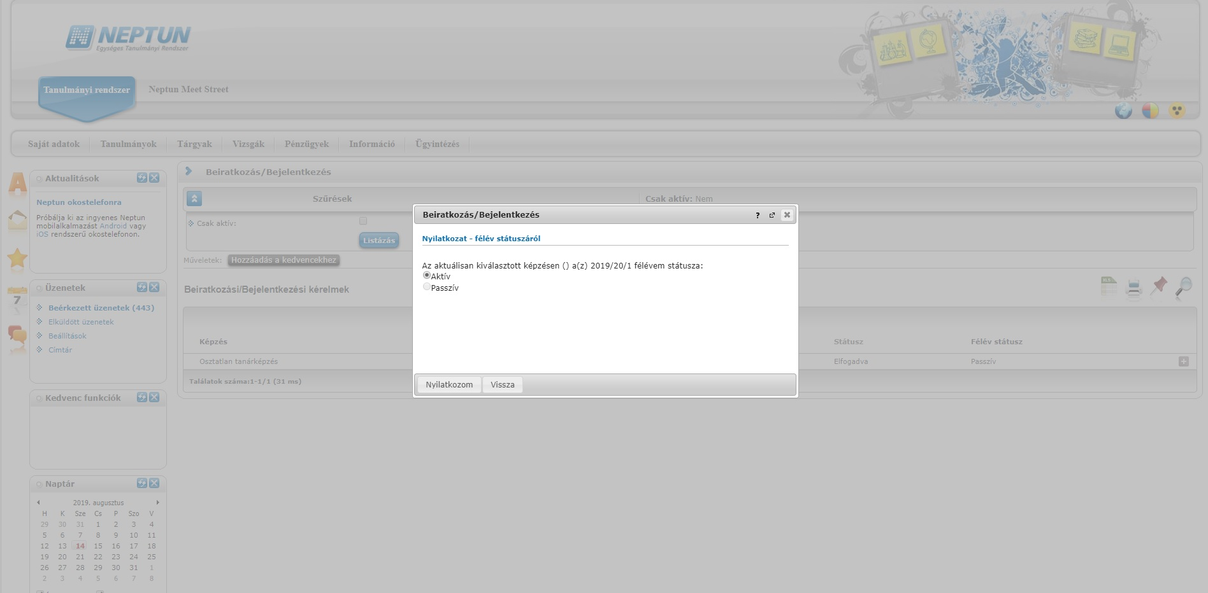
Please choose from the following options in the pop-up window:
Active
Passive

